Slide 1
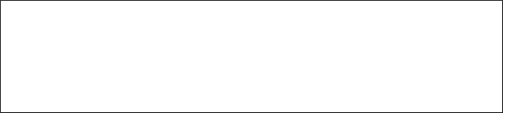

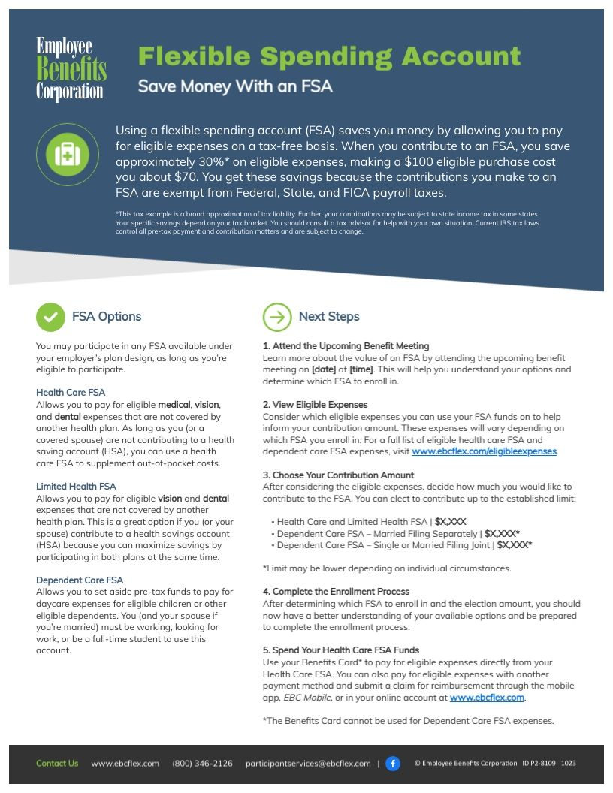

Instructions
Please ensure that you fill in your plan limits [A], remove any FSAs that you aren’t offering [B], input details about upcoming benefit meetings [C], and delete these instructions before sharing the flyer with your employees.
C
B
A
Notes:
Note title
Type your notes here. They will be viewable in presenter view.

Slide 2








Flexible Spending Account
Save Money With an FSA
Using a flexible spending account (FSA) saves you money by allowing you to pay for eligible expenses on a tax-free basis. When you contribute to an FSA, you save approximately 30%* on eligible expenses, making a $100 eligible purchase cost you about $70. You get these savings because the contributions you make to an FSA are exempt from Federal, State, and FICA payroll taxes.
*This tax example is a broad approximation of tax liability. Further, your contributions may be subject to state income tax in some states. Your specific savings depend on your tax bracket. You should consult a tax advisor for help with your own situation. Current IRS tax laws control all pre-tax payment and contribution matters and are subject to change.
FSA Options
Next Steps
You may participate in any FSA available under your employer’s plan design, as long as you’re eligible to participate.
Health Care FSA
Allows you to pay for eligible medical, vision, and dental expenses that are not covered by another health plan. As long as you (or a covered spouse) are not contributing to a health saving account (HSA), you can use a health care FSA to supplement out-of-pocket costs.
Limited Health FSA
Allows you to pay for eligible vision and dental expenses that are not covered by another health plan. This is a great option if you (or your spouse) contribute to a health savings account (HSA) because you can maximize savings by participating in both plans at the same time.
Dependent Care FSA
Allows you to set aside pre-tax funds to pay for daycare expenses for eligible children or other eligible dependents. You (and your spouse if you’re married) must be working, looking for work, or be a full-time student to use this account.
1. Attend the Upcoming Benefit Meeting
Learn more about the value of an FSA by attending the upcoming benefit meeting on [date] at [time]. This will help you understand your options and determine which FSA to enroll in.
2. View Eligible Expenses
Consider which eligible expenses you can use your FSA funds on to help inform your contribution amount. These expenses will vary depending on which FSA you enroll in. For a full list of eligible health care FSA and dependent care FSA expenses, visit www.ebcflex.com/eligibleexpenses.
3. Choose Your Contribution Amount
After considering the eligible expenses, decide how much you would like to contribute to the FSA. You can elect to contribute up to the established limit:
Health Care and Limited Health FSA | $X,XXX
Dependent Care FSA – Married Filing Separately | $X,XXX*
Dependent Care FSA – Single or Married Filing Joint | $X,XXX*
*Limit may be lower depending on individual circumstances.
4. Complete the Enrollment Process
After determining which FSA to enroll in and the election amount, you should now have a better understanding of your available options and be prepared to complete the enrollment process.
5. Spend Your Health Care FSA Funds
Use your Benefits Card* to pay for eligible expenses directly from your Health Care FSA. You can also pay for eligible expenses with another payment method and submit a claim for reimbursement through the mobile app, EBC Mobile, or in your online account at www.ebcflex.com.
*The Benefits Card cannot be used for Dependent Care FSA expenses.
Contact Us www.ebcflex.com (800) 346-2126 participantservices@ebcflex.com |
© Employee Benefits Corporation ID P2-8109 1023
Notes:
Note title
Type your notes here. They will be viewable in presenter view.

