Slide 1


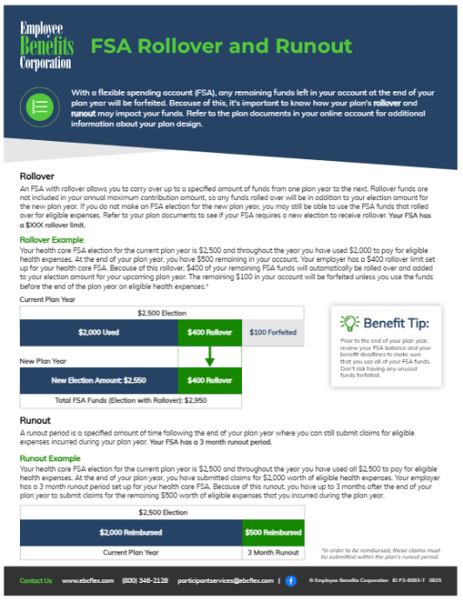

Instructions
Included in the following slides are three documents that go over different plan design options—rollover and runout, grace period and runout, and standalone runout. Please ensure that you remove the pages that aren't applicable to your plan. If you only offer rollover or grace period, you can delete the runout sections at the bottom of the applicable pages (A).
At the end of each plan design explanation there is a sentence that identifies your plan's rollover, runout, and grace period details (B). Please confirm and modify these details, if needed, prior to distribution.
B
A

Slide 2
















FSA Rollover and Runout
With a flexible spending account (FSA), any remaining funds left in your account at the end of your plan year will be forfeited. Because of this, it's important to know how your plan's rollover and runout may impact your funds. Refer to the plan documents in your online account for additional information about your plan design.
Rollover
An FSA with rollover allows you to carry over up to a specified amount of funds from one plan year to the next. Rollover funds are not included in your annual maximum contribution amount, so any funds rolled over will be in addition to your election amount for the new plan year. If you do not make an FSA election for the new plan year, you may still be able to use the FSA funds that rolled over for eligible expenses. Refer to your plan documents to see if your FSA requires a new election to receive rollover. Your FSA has a $XXX rollover limit.
Rollover Example
Your health care FSA election for the current plan year is $2,500 and throughout the year you have used $2,000 to pay for eligible health expenses. At the end of your plan year, you have $500 remaining in your account. Your employer has a $400 rollover limit set up for your health care FSA. Because of this rollover, $400 of your remaining FSA funds will automatically be rolled over and added to your election amount for your upcoming plan year. The remaining $100 in your account will be forfeited unless you use the funds before the end of the plan year on eligible health expenses.*
Current Plan Year
$2,500 Election
Benefit Tip:
$2,000 Used
$400 Rollover
$100 Forfeited
Prior to the end of your plan year, review your FSA balance and your benefit deadlines to make sure that you use all of your FSA funds. Don't risk having any unused funds forfeited.
New Plan Year
New Election Amount: $2,550
$400 Rollover
Total FSA Funds (Election with Rollover): $2,950
Runout
A runout period is a specified amount of time following the end of your plan year where you can still submit claims for eligible expenses incurred during your plan year. Your FSA has a 3 month runout period.
Runout Example
Your health care FSA election for the current plan year is $2,500 and throughout the year you have used all $2,500 to pay for eligible health expenses. At the end of your plan year, you have submitted claims for $2,000 worth of eligible health expenses. Your employer has a 3 month runout period set up for your health care FSA. Because of this runout, you have up to 3 months after the end of your plan year to submit claims for the remaining $500 worth of eligible expenses that you incurred during the plan year.
$2,500 Election
$2,000 Reimbursed
$500 Reimbursed
Current Plan Year
3 Month Runout
*In order to be reimbursed, these claims must be submitted within the plan's runout period.
Contact Us www.ebcflex.com (800) 346-2126 participantservices@ebcflex.com |
© Employee Benefits Corporation ID P2-8093-T 0925

Slide 3
FSA Grace Period and Runout
With a flexible spending account (FSA), any remaining funds left in your account at the end of your plan year will be forfeited. Because of this, it's important to know how your plan's grace period and runout may impact your funds. Refer to the plan documents in your online account for additional information about your plan design.
Grace Period
A grace period is an additional period of time for you to incur claims after the end of a plan year. Your FSA has a 2 month and 15 day grace period.
Grace Period Example
Your health care FSA election for the current plan year is $2,500 and throughout the year you have used $2,000 to pay for eligible health expenses. At the end of your plan year, you have $500 remaining in your account. Your employer has a 2 month and 15 day grace period set up for your health care FSA. Because of this grace period, you have up to 2 months and 15 days following the end of your plan year to use the $500 worth of remaining funds on eligible health expenses.*
$2,500 Election
Benefit Tip:
$2,000 Used
$500 Used
Prior to the end of your plan year, review your FSA balance and your benefit deadlines to make sure that you use all of your FSA funds. Don't risk having any unused funds forfeited.
Current Plan Year
Grace Period
Runout
A runout period is a specified amount of time following the end of your plan year where you can still submit claims for eligible expenses incurred during your plan year. Your FSA has a 3 month runout period.
Runout Example
Your health care FSA election for the current plan year is $2,500 and throughout the year you have used all $2,500 to pay for eligible health expenses. At the end of your plan year, you have submitted claims for $2,000 worth of eligible health expenses. Your employer has a 3 month runout period set up for your health care FSA. Because of this runout, you have up to 3 months after the end of your plan year to submit claims for the remaining $500 worth of eligible expenses that you incurred during the plan year.
$2,500 Election
$2,000 Reimbursed
$500 Reimbursed
Current Plan Year
3 Month Runout
*In order to be reimbursed, these claims must be submitted within the plan's runout period.
Contact Us www.ebcflex.com (800) 346-2126 participantservices@ebcflex.com |
© Employee Benefits Corporation ID P2-8093-T 0925

Slide 4
FSA Runout
With a flexible spending account (FSA), any remaining funds left in your account at the end of your plan year will be forfeited. Because of this, it's important to know how your plan's runout may impact your funds. Refer to the plan documents in your online account for additional information about your plan design.
Runout
A runout period is a specified amount of time following the end of your plan year where you can still submit claims for eligible expenses incurred during your plan year. Your FSA has a 3 month runout period.
Runout Example
Your health care FSA election for the current plan year is $2,500 and throughout the year you have used all $2,500 to pay for eligible health expenses. At the end of your plan year, you have submitted claims for $2,000 worth of eligible health expenses. Your employer has a 3 month runout period set up for your health care FSA. Because of this runout, you have up to 3 months after the end of your plan year to submit claims for the remaining $500 worth of eligible expenses that you incurred during the plan year.
$2,500 Election
Benefit Tip:
$2,000 Reimbursed
$500 Reimbursed
Prior to the end of your plan year, review your FSA balance and your benefit deadlines to make sure that you use all of your FSA funds. Don't risk having any unused funds forfeited.
Current Plan Year
3 Month Runout
Contact Us www.ebcflex.com (800) 346-2126 participantservices@ebcflex.com |
© Employee Benefits Corporation ID P2-8093-T 0925

